Slide 1

Technological Environment in Management Fundamentals

Slide 2
Group Member

Slide 3

Technological Environment in Management Fundamentals
This presentation explores the ever-evolving technological landscape and its impact on management principles. It will delve into key concepts, trends, and strategies relevant to the modern business environment.

Slide 4
The Concept of Technology in Management
1
What is Technology?
Technology refers to the tools, techniques, and knowledge used to create products and services, encompassing hardware, software, processes, and information.
2
Relevance in Management
Technology plays a vital role in management by enhancing efficiency, streamlining operations, facilitating communication, and providing insights for better decision-making.

Slide 5
Dynamics of Technological Change
Factors Driving Technological Change:-
Research and Development (R&D)
2. Market Demand
3. Competitive Pressure
4. Government policy

Slide 6
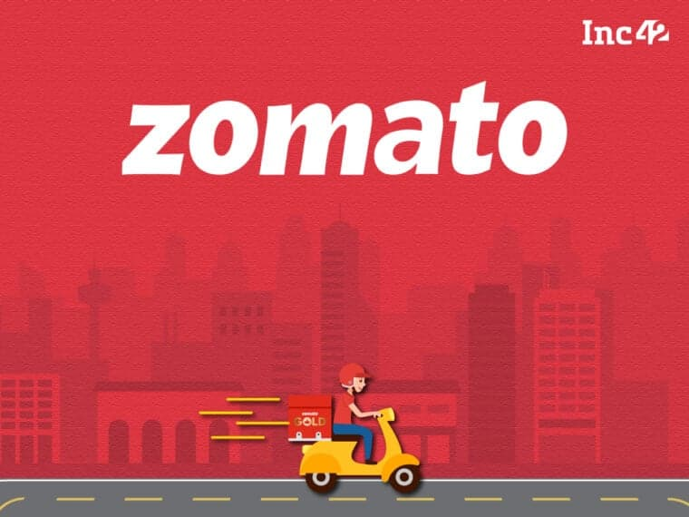
Case Study – Zomato
Zomato has embraced dynamic technological innovations to enhance its services, improve efficiency, and offer a personalized user experience. These changes have helped Zomato stay ahead in the competitive food delivery industry.

Slide 7
Case Study – Zomato
Key Technological Innovations Driven by Change
01
02
03
AI-Powered Personalization
Real-Time Order Tracking and Delivery Optimization
Automation in Logistics and Warehouse Management
Zomato leverages AI to deliver customized recommendations based on users' preferences, order history, and location.
Zomato uses algorithms to optimize routes for faster delivery and reduce wait times.
Advanced automation technologies help streamline warehouse operations, improving inventory management and order fulfillment.

Slide 8

Importance of technological environment
1
Efficiency:
Organizations constantly struggle with the goal of maximizing their output while reducing the inputs. This is where technology is a game changer, especially automation. With automated processes, repetitive and redundant operations take minimal time or labor while ensuring expected output.
2
Customer experience:
Technology can help businesses provide better customer service by making information and services easier to access.

Slide 9
Importance of technological environment
3
Competitive advantage:
Technology can help businesses develop unique products and services, or provide services faster than competitors.
4
Cost savings:
Technology can help businesses reduce costs by reducing labor costs and overhead. Since machines are way faster than humans, certain tasks that may require an incredible amount of manual work and attention to detail can be easily accomplished with the help of technology.

Slide 10

Technology Policy in Management
Strategic Alignment
Investment & Adoption
Organizations must develop clear technology policies that align with their overall business goals and strategic priorities.
Technology policies guide investment decisions, technology adoption, and the implementation of new systems.
Ethical Considerations
Policies should address ethical implications of technology use, data privacy, cybersecurity, and responsible innovation.

Slide 11

R&D Scenario in India
What is R&D ?
Research and Development means creating new ideas, technology and solution for progress
Current Situation in India :- India Spends Only 0.7% of its GDP on R&D
Main Players :-
Government :- ISRO , DRDO , CSIR
Private co. :- TATA , Infosys, sun Pharma
Achievement :-
Big Achievement :- Chandryaan-3 , Convaxin , Solar Energy Project

Slide 12
Challenges & Opportunities
Challenges :-
India Invests less money in R&D compared to big countries like china or the USA
Collaboration Between colleges, companies , and government in weak
Many Skilled Workers Move abroad for Better Opportunities
Opportunities :-
Government programs like make in India and Startup India encourage innovation
Sectors like electric vehicles, healthcare and green energy are growing
India has a young and talented population ready to innovates
Visual Ideas
Show an example like ISRO chandryaan-3
Including simple charts showing india low R&D spending compared to other countries

Slide 13

Technology Transfer
Definition :- Technology Transfer is the process of moving scientific and technological knowledge from research institution and universities to industry for commercialization
Importance :-
Commercialize Innovation
Promote economic growth
Ensure quality and compliance
Challenges
Cross-funcation interfaces ( Lack of information sharing , Knowlage )
Uncertainty

Slide 14
Conclusion: Embracing the Technological Landscape
1
Key Takeaways
Adaptability
Embrace continuous learning and adaptability to thrive in a rapidly changing technological landscape.
2
Strategic Planning
3
Develop proactive technology strategies aligned with business goals and priorities.
Innovation
4
Foster a culture of innovation, experiment with new technologies, and embrace emerging trends.

